Slide 1



CEN prEN 17632: Semantic Modelling and Linking (SML)
in the Built Environment | Michel Böhms, presented in ISO TC67 AG1

Slide 2
overview
CEN preen 17632: Semantic Modelling and Linking (SML)
01.
The playing field
02.
goals
03.
solution
04.
scope
05.
topics
06.
example
07.
process
08.
future

Slide 3
The playing field
* Including maintain, renovate and repurpose, demolish & recycle
The built environment
Asset Life-Cycle (LC)
Program
Design
Build
Operate*
Start of Life
End of Life
Built Environment
Network/Collection
ComplexAsset
Asset
Asset Supply-Chain (SC) / Asset Breakdown
System
Space/Element
Component
Material

Slide 4
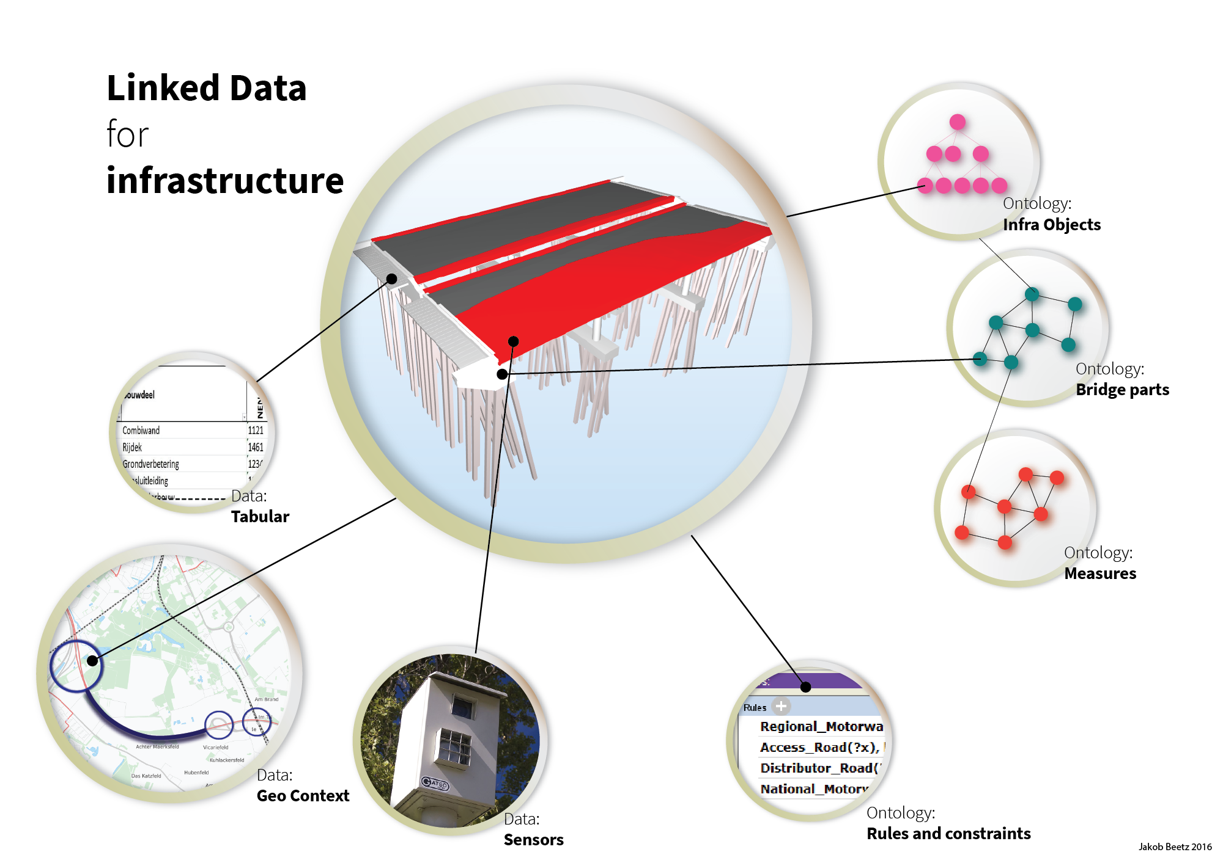
goals
Source: Jakob Beetz (2016)
Data integration
BIM standard
Industry ‘standard’
National regulation standard
GIS standard
IoT standard

Slide 5
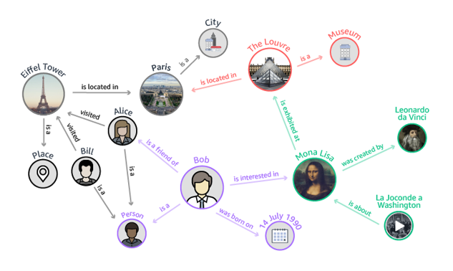
goals
Given meaning by distributed, linked ontologies*
* In NL often the term OTL – Object Type Library is used

Slide 6


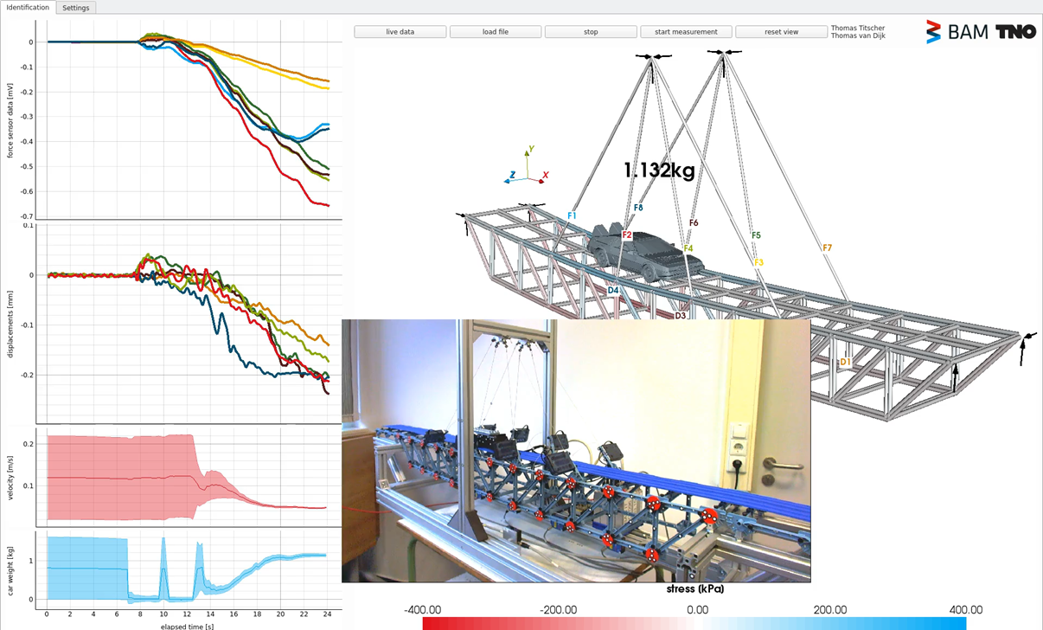
goals
Innovation example: predictive digital twin (DT)

Slide 7
goals
Findable
F1. (Meta)data are assigned a globally unique and persistent identifier
F2. Data are described with rich metadata (defined by R1 below)
F3. Metadata clearly and explicitly include the identifier of the data they describe
F4. (Meta)data are registered or indexed in a searchable resource
Accessible
A1. (Meta)data are retrievable by their identifier using a standardised communications protocol
A1.1 The protocol is open, free, and universally implementable
A1.2 The protocol allows for an authentication and authorisation procedure, where necessary
A2. Metadata are accessible, even when the data are no longer available
Interoperable
I1. (Meta)data use a formal, accessible, shared, and broadly applicable language for knowledge representation.
I2. (Meta)data use vocabularies that follow FAIR principles
I3. (Meta)data include qualified references to other (meta)data
Reusable
R1. (Meta)data are richly described with a plurality of accurate and relevant attributes
R1.1. (Meta)data are released with a clear and accessible data usage license
R1.2. (Meta)data are associated with detailed provenance
R1.3. (Meta)data meet domain-relevant community standards
FAIR data
Source: www.go-fair.org

Slide 8
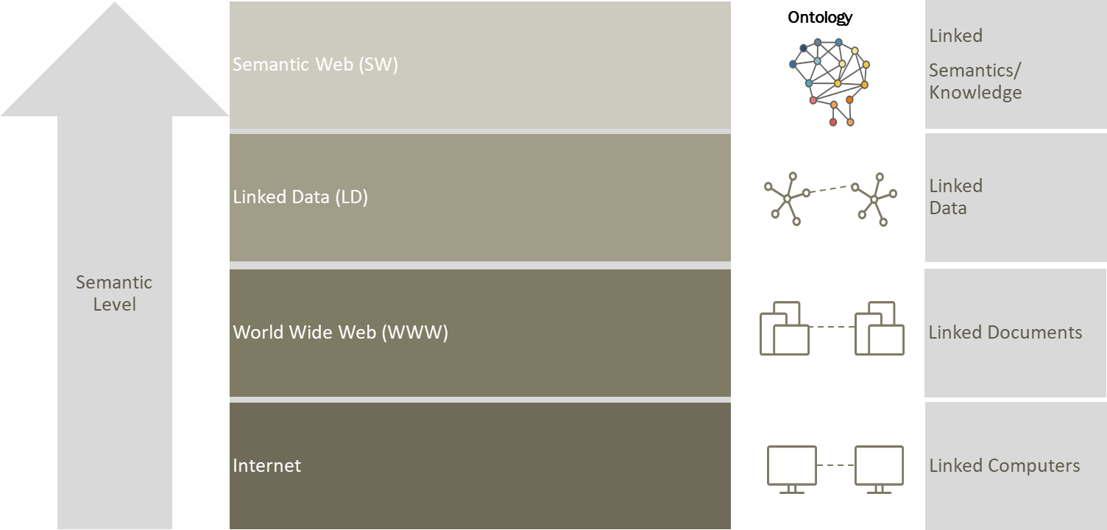
solution
W3C Linked Data & Semantic Web Technology
Passive Role (KM)
Active Role
R – Reusable
I - Interoperable
A - Accessible
F – Findable

Slide 9
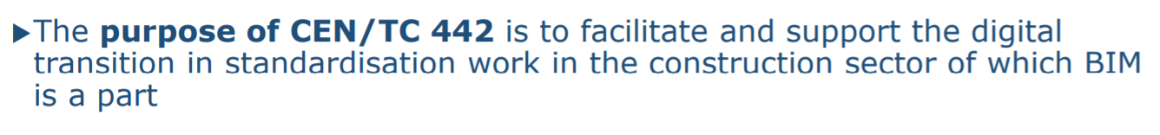
Solution
But… Tech is not enough!
We need standards that support the application of that technology in industry
Here: the built environment
Helping the information managers and modellers in practice
CEN TC442 (BIM) / WG4 (Support Data Dictionaries) /TG3 (Semantic Modelling and Linking) = prEN 17632
Note: ‘Data Dictionary’ here to be interpreted as ‘Ontology’! (unhandy name like bSI bSDD)

Slide 10
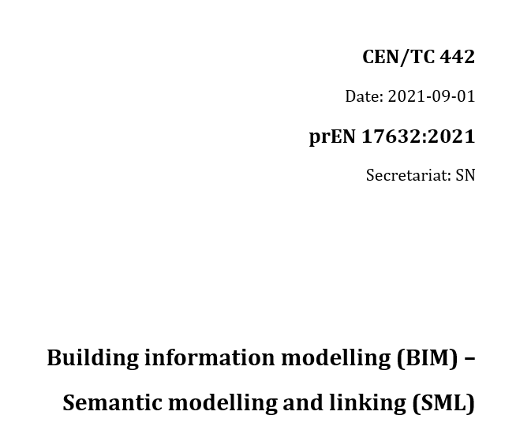
solution
Editorial Team
Benno Koehorst (RWS, NL) – Chair
Michel Böhms (TNO, NL) – Editor
Sara Asmussen (Leif Hansen Bygherrerådgivning, ISO 12006-3, GL)
Phil Jackson (University of Surrey, UK)
Davis Kantor (CRB, CH)
Ralf Klein (KU Leuven, BE)
Martin Schroeder (Bosch, DE)
Hugo Avalos (Knauf, DE)
Sanne Jansweijer (NEN, NL) – Secretariat
Paul van Rijsinge (NEN, NL) – Secretariat
Extended TG & external support/advice/inspiration
Espen Schulze (Cobuilder, NO)
Frédéric Grand (Cobuilder/bSI bSDD, NO)
Giorgio Schiavini (iBIMi, IT)
Vlad Nyvlt (Institute of Technology and Business , CZ)
Wolfgang Wilkes (University of Hagen, DE)
Sigve Pettersen (Fremby AS, NO)
Tim Lemoine (BBRI, BE)
Chi Ho Lau (bSI bSDD, NO)
Peter Muigg (CAD Anwendungen Muigg, AT)
Radboud Baayen (STABU, ISO 12006-3, NL)
Mick Baggen, Jaap Bakker (RWS, NL)
Daan Oostinga, Sander Stolk, Wouter Lubbers (Semmtech, NL)
Rik Opgenoort, Redmer Kronemeijer (CROW, NL)
Lucas Verhelst, Luuk Wijnholts, Miltos Gatzios (BIM Connected, NL)
Leo van Ruijven (Croonwolter en dros, NL)
Niels Hoffmann (Provincie Noord-Holland, NL)
Niels Reyngoud (Provincie Gelderland, NL)
Wouter van Riel (Infralytics, NL)
Dik Spekking (BIM Loket, NL)
René Wubbels (ProRail, NL)
Irene Polikof, Holger Knublaug, David Price (TQ, US)
Jan Voskuil (Taxonic, NL)
Berwich Sluer (Boskalis, NL)
preEN 17632

Slide 11

scope
Metalevels & language levels
Information modelling
M2: Meta-’information model’
L1:
information
language
optional
L2:
Meta-
‘information
language’
of type
of type
Top level information model
M1: Information model
of type
of type
Information linking
of type
M0: Information set
of type
of type
optional
: “some element in”

Slide 12
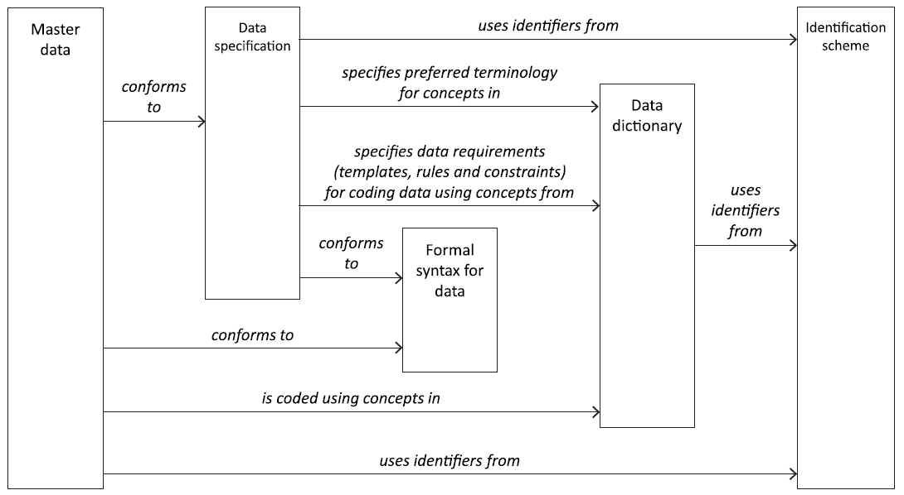
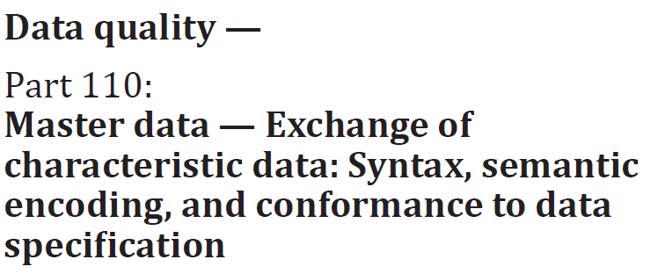
scope
Data architecture for master data as specified by the ISO 8000 series
URI
Strategy
Ontologies
RDF, RDFS, OWL, SHACL, SKOS
Serialisation: XML, Turtle, JSON-LD, TriG, …

Slide 13
scope
Use case types versus modelling power
LoC-3
Advanced ontology
Strong
semantic
modelling
OWL or
SHACL
Data
integration
LoC-2
Basic ontology
RDFS only
Data exchange
or sharing
LoC-1
Vocabulary/dictionary/
thesaurus
Weak
semantic
modelling
Alignment of terms & definitions
RDF + SKOS

Slide 14
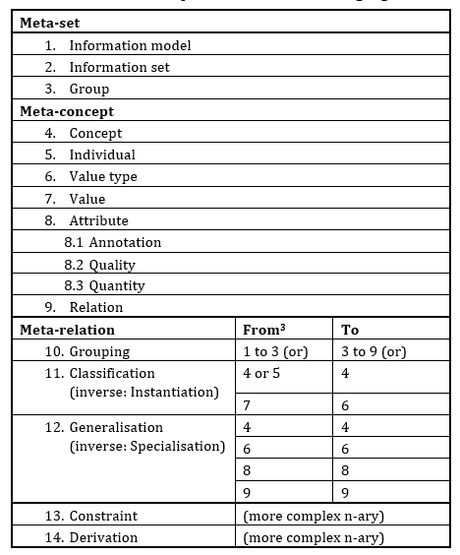
topics
Conceptual information language

Slide 15
topics
Language bindings
To: RDF +
SKOS
RDFS
OWL
SHACL

Slide 16
topics
Uri Strategy

Slide 17
Topics
Combining languages
EXTERNAL
SKOS
T1 a skos:Concept
skos:relatedMatch
T3 a skos:Concept
skos:definition
skos:prefLabel
skos:broader T2
(NO IMPORT)
(weak linking)
RDFS
rdfs:seeAlso
C1 a rdfs:Class
rdfs:subClassOf
C3 a rdfs:Class
skos:definition
skos:prefLabel
rdfs:subClassOf C2
rdfs:subPropertyOf
P2 a rdf:Property
P a rdf:Property
rdfs:domain
rdfs:range
IMPORT
delivers
sh:targetClass
OWL
SHACL
P a owl:ObjectProperty
CX / CXShape sh:NodeShape’s
Union-domain
delivers
sh:Property
sh:Property
sh:Property
sh:Property (complex/extra)
C1 a owl:Class
Restriction
(cardinality or value)
sh:targetClass

Slide 18
topics
Complex properties like complex quantities reusing QUDT
owl:Object
Property
rdf:type
quantity
Kind:
Length
ex:height
sml:
Quantity
Value
sml:hasQuantityKind
rdfs:range
ex:Door
Implicit
in RDF
rdf:type
(drived)
unit:M
rdf:type
ex:Door_1
_:height1
sml:hasUnit
ex:height
rdf:value
“2.4”
^^xsd:double

Slide 19
topics
annotation

Slide 20
Topics
Top level taxonomy
hasInterior
Spatial
Entity
Concreet
Concept
hasPart
hasBoundary
Activity
hasState
triggers
hasTemporalEntity
Temporal
Entity
State
begins
Event
ends
transforms
performs
transforms
hasState
triggers
triggers
Top
Concept
Information
Object
Physical
Object
hasState
isDescribedBy
hasPart
hasPart

Slide 21
topics
Top level taxonomy – bit more precise
(W3C Time ontology)

Slide 22
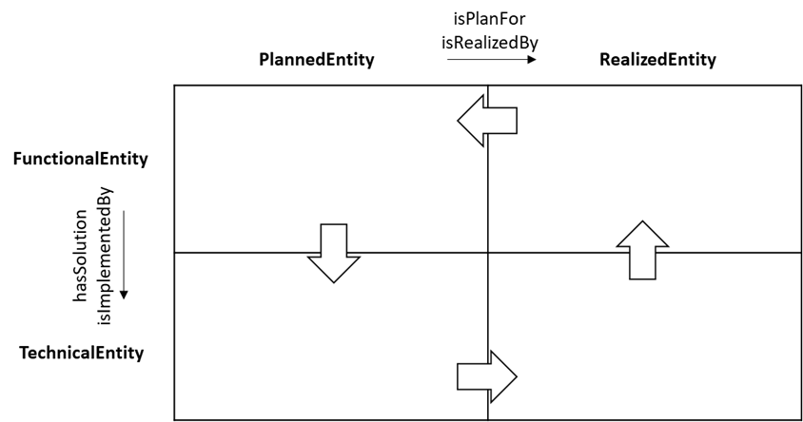
topics
Systems engineering

Slide 23
topics
linking

Slide 24
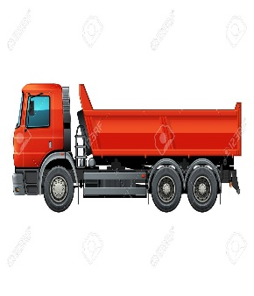
example
Modelling structures and their usage
accuracy
height
velocity
Bridge
has legal speed
load level type
Vehicle
Slab
Deck
{ … }
Non-geometric vehicle properties

Slide 25
example
Coding according to SML

Slide 26
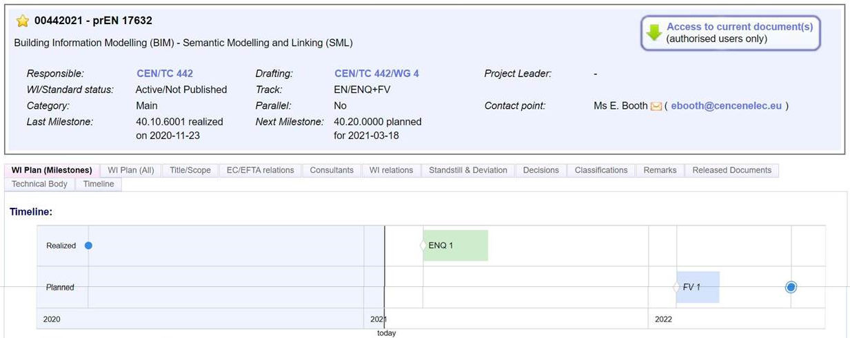
process
Benno Koehorst (RWS)
~200 comments
processed
10 june
21 october

Slide 27
future
Finish SML Part 1
Start SML Part 2: more domain-specific modelling patterns (PNWI), based on NEN 2660-2:
Industrial application, in NL alone:
RWS AIRBIM RWS-OTL
City of Amsterdam Engineering Dept.
CROW BOR-OTL
TenneT
Province Gelderland
Province Noord-Holland
GWSW / GWSL
CBNL, extending top level model like with “RoadNetwork”, “Building”, “Bridge”, “Tunnel”, …
Pavement Information Model (PIM), Boskalis
….. many more
spatial regions versus real objects
materialization of physical objects (concrete, steel, asphalt, …)
interaction between objects including connections, interfaces and ports
requirements, unstructured and structured
client needs
laws and regulations
sector recommendations
Implicit groups like “all main girders of a steel bridge”

Slide 28
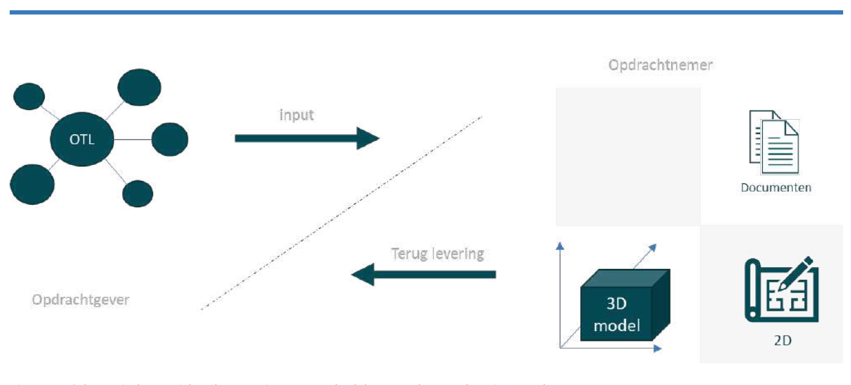


future
BIM and linked data coming together
©

Slide 29
future
Note
JSON-LD can be a common denominator:
W3C LD/SW
WebDev
?bSI (now JSON)
Potential ingredients
buildingSmart (bSI)
IFC, ifcOWL, ifcJSON
bSI bSDD (in ISO 12006-3, JSON ?)
W3C RDF-star, Turtle-star, SPARQL-star (‘triple as subject’), compare LPGs
W3C LBD BOT ontology (“lightweight IFC-LD”)
Check out: https://github.com/LBDserver by Jyrki Oraskari
ISO ICDD
Packaging docs incl. LD docs
Itself LD-based (meta-level)
CEN TC442 WG4 Data Template
“Attributes for properties”
Implemented in ‘ISO 12006-3 Revised’

Slide 30
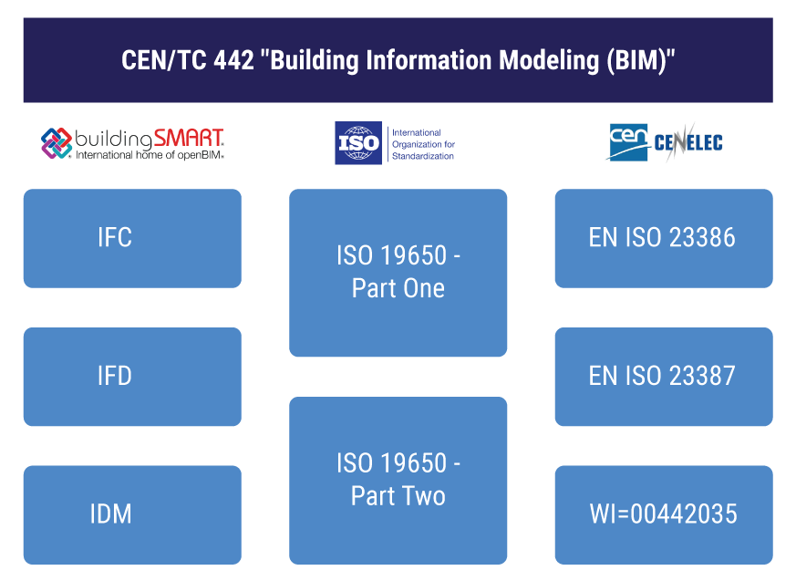
future
CEN TC442 internal alignment
“Data Templates”
“Attributes for properties”
Implemented in ‘ISO 12006-3 Revised’
SML: + implemented in W3C LD/SW
IFC-based data sets
SML: + W3C LD/SW-based data sets

Slide 31
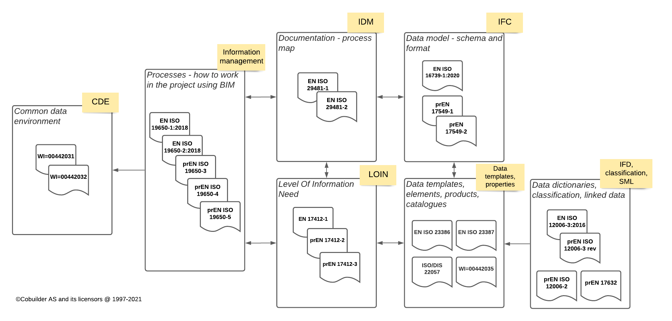
future
CEN TC442 internal alignment – current positioning

Slide 32
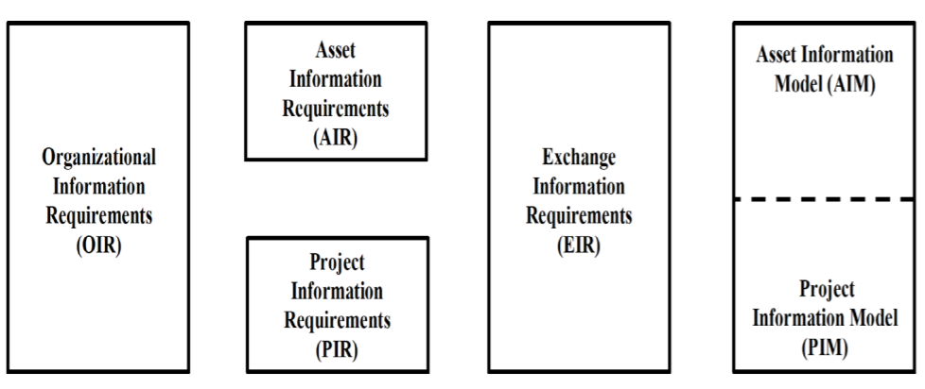
future
Much More to be done … in ISO 19650-speak:

Slide 33
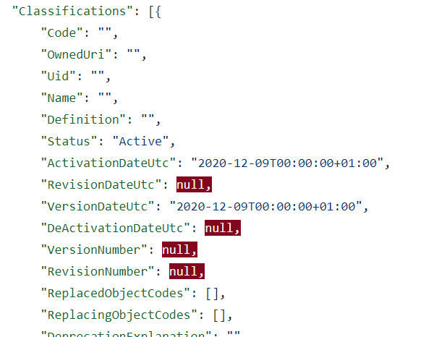
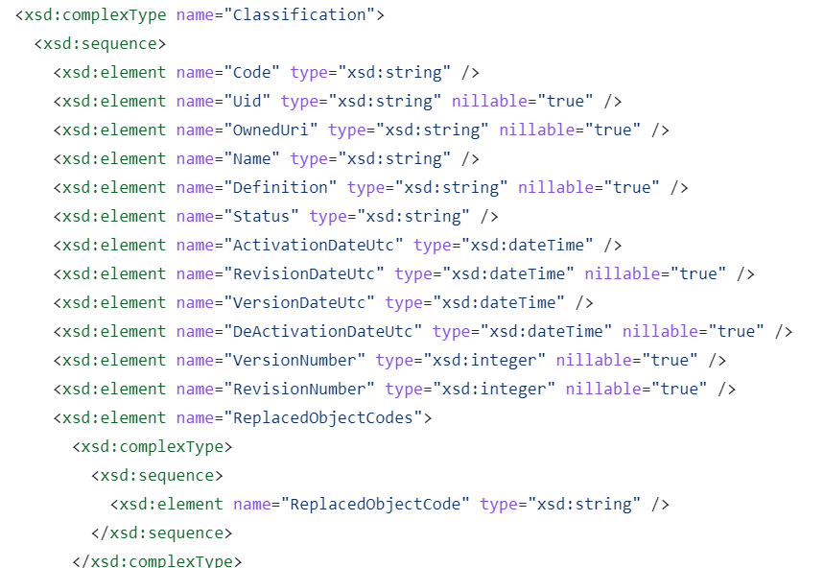
future
Bsi bSDD json experiments /1
GitHub - buildingSMART/bSDD: bSDD development repo
Database: import & output

Slide 34
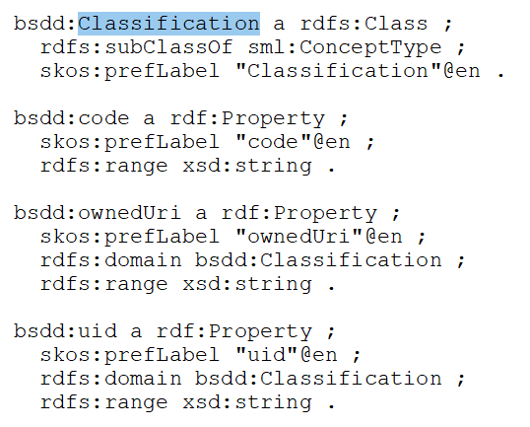
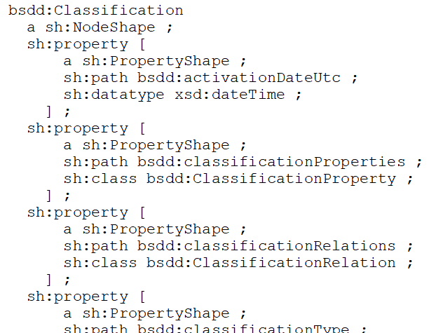
future
Bsi bSDD json experiments /2
RDFS + SHACL

Slide 35
future
Bsi bSDD json experiments /3
Need for harmonization!
ISO 12006-3:2021 is NOT bSDD JSON conceptually!
Step 1: Good 12006-3:2021-LD variant
Step 2: harmonize with bSI

Slide 36


Thank you for
your time

